Slide 1
Executive Summary
A review of the current status of Flight safety and business
Presented by: Manuel Duran

Slide 2
Executive Summary OUTLINE
KPI’s From Provided Data
Difference Between Fatal Accidents & Aircraft Incidents
Aircraft vs. Vehicle Fatality Comparison
U.S. Airline Revenue Review
Conclusion

Slide 3



KPI’s From Provided Data

Slide 4
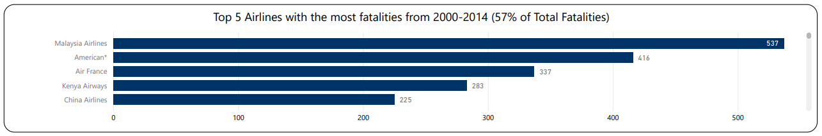
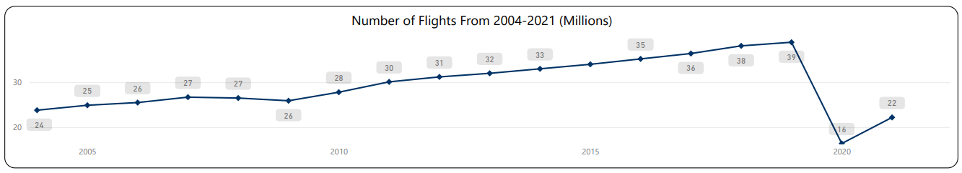
KPI’s From Provided Data cont.

Slide 5

Insights from KPI Information
Possible difference between Incidents and Fatal Accidents
Flights have increased from 2004-2021
Only dip was due to Covid-19 (2020)
Airlines with the highest fatalities are inflated due to one air flight.
Ex. Malaysia Airlines Flight 370 (227) & Flight 447 (228)

Slide 6
Difference Between Fatal Accidents & Aircraft Incidents
Fatal Accidents
Aircraft Incidents
An occurrence associated with operation of an aircraft.
Timeframe: anytime a person boards the aircraft for flight and when flight is disembarked.
Includes:
Deaths or Hospitalization
Fractures
Third-Degree Burns
Events that prevent the aircraft from performing flight duties
Includes
Flight System Malfunction
Flight Crew Injury or Illness
Exceeding of Maximum Weight Limit
Engine Failure Before Take Off
Source: Eaa.org

Slide 7
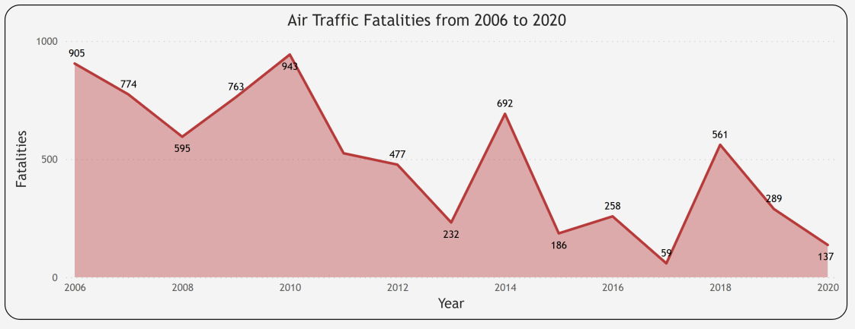
Aircraft vs. Vehicle Fatality Comparison
Source: https://www.statista.com/statistics/263443/worldwide-air-traffic-fatalities/

Slide 8
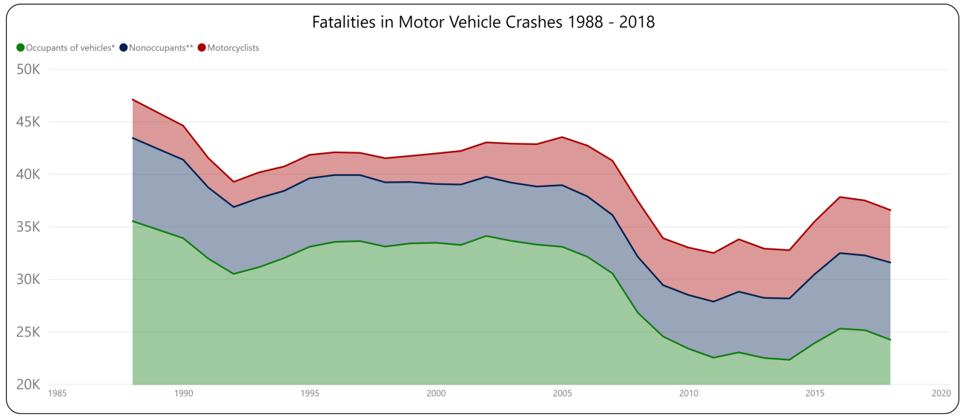
Aircraft vs. Vehicle Fatality Comparison Cont.
* Vehicles: passenger cars, light and large trucks, buses, and other/unknown.
** Nonoccupants: pedestrians, pedal cyclists, and other/unknown.
Source: nhtsa.dot.gov

Slide 9
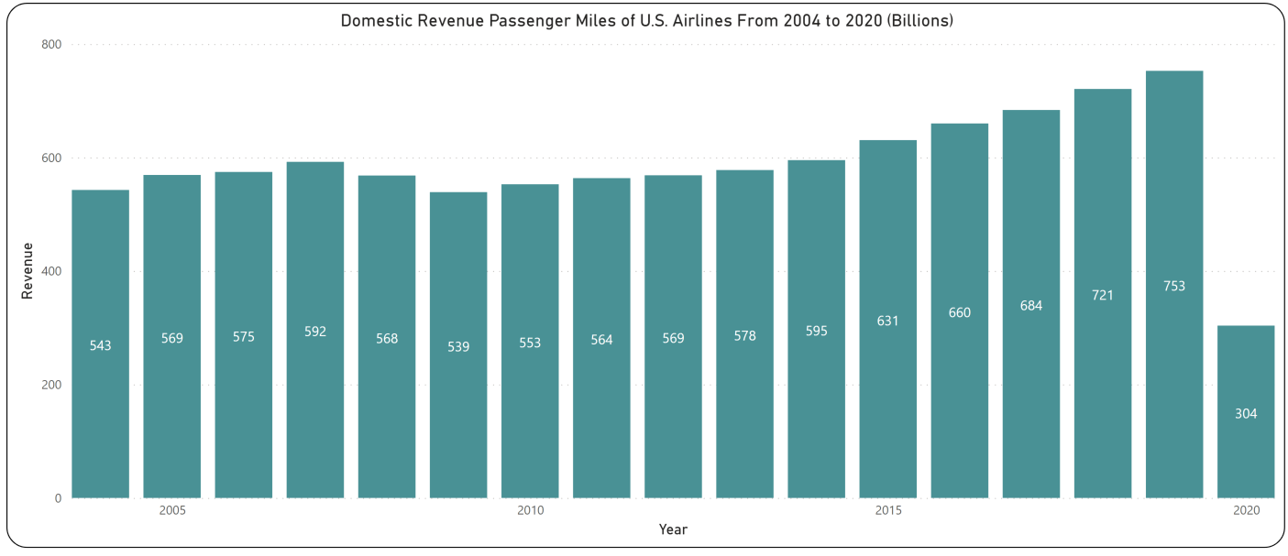
U.S. Airline Revenue Review
Source: https://www.transtats.bts.gov/Data_Elements.aspx?Data=1

Slide 10
Conclusion
Media may manipulate customers by explaining flight incidents, should be included in fatal accident count.
Flights and Flight Revenue have increased substantially overtime. Covid-19 appears to be the reason for 2020 dip.
Air Flight Travel has produced significantly less fatalities over the years compared to motor travel.
We must take action to inform our consumers Flight Travel is the better and safer way of travel.

Slide 11

Questions?

